Slide 1
Third Quarter Life Bible Study
November 1, 2026

Slide 2
Class Calendar - November
7 Harvest Men’s Bible Study – 9:00 a.m. @ Corner Bakery
9 Women’s Mahjong Mingle – 7:00 p.m. @ HFBC Loop Campus – Oasis Room
17 Gracewood Thanksgiving Ministry – 5:30-8:00 p.m. @ Gracewood
19 3Q Men’s Fellowship: Texans’ Tailgate – 6:00-8:00 p.m. @ Darrell Pennington’s Home
21 Harvest Men’s Bible Study – 9:00 a.m. @ Corner Bakery
21 MenServe – 8:00 a.m.-1:00 p.m. @ Location TBD

Slide 3
Class Calendar - December
5 Harvest Men’s Bible Study – 8:00-9:00 a.m. @ Corner Bakery
6 3Q Class Fellowship: Jingle and Mingle –5:30-8:00 p.m. @ Leenie & Jacky Ralston’s Home
14 Women’s Mahjong Mingle – 7:00 p.m. @ HFBC Loop Campus – Oasis Room
19 Harvest Men’s Bible Study – 8:00-9:00 a.m. @ Corner Bakery

Slide 4
Paul’s First Trip to Europe
(Acts 16-18) also known as
Paul’s Second Missionary Journey
Peter Ireland
(substitute for Robert Schwartz)
Notes:
Thank you David and Julie.
Robert started Acts in September 2025. Has completed 40 lessons. He will return to Acts 16 next week,

Slide 5
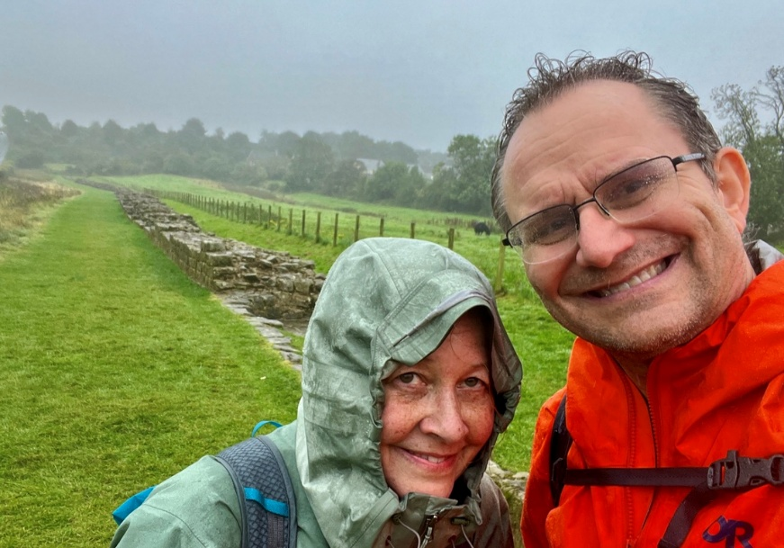
One of Our Passions: Long Distance Walking
Hadrian’s Wall Path
England/Scotland border
Most Northern extent of Roman Empire
84 miles, 8 days
“Inn-to-inn”
Modern equipment
Paul’s 2nd Journey:
Antioch to Troas
  ~750 miles
Neapolis to Cenchreae
  450 miles
  ~15 miles/day, with stops
Notes:
To introduce my wife Janet and I, I share a photo of us pursuing one of our passions – Long Distance Walking.
SEHN-kree-ay

Slide 6
Introduction
In 2024, Janet and I had the privilege of retracing Paul’s steps in Greece with a couple of Liberty University seminary professors and a local Greek guide.
Today, we all will travel together, following Luke’s account in Acts 16-18 of Paul’s first visit to Greece ~49-52 AD. We will explore the context that can be lost to a modern reader. Caveat: I will skip some bits!
With Paul, we will walk along Roman roads, defeat a python, and call out the futility of the Greek gods.
Takeaways: An increased understanding of the context of Acts; the reality of the account; Paul’s evangelism journey was varied and tough.
Notes:
Difficult questions, I refer you to Nikki Kalengis, as we walk through her home town!

Slide 7
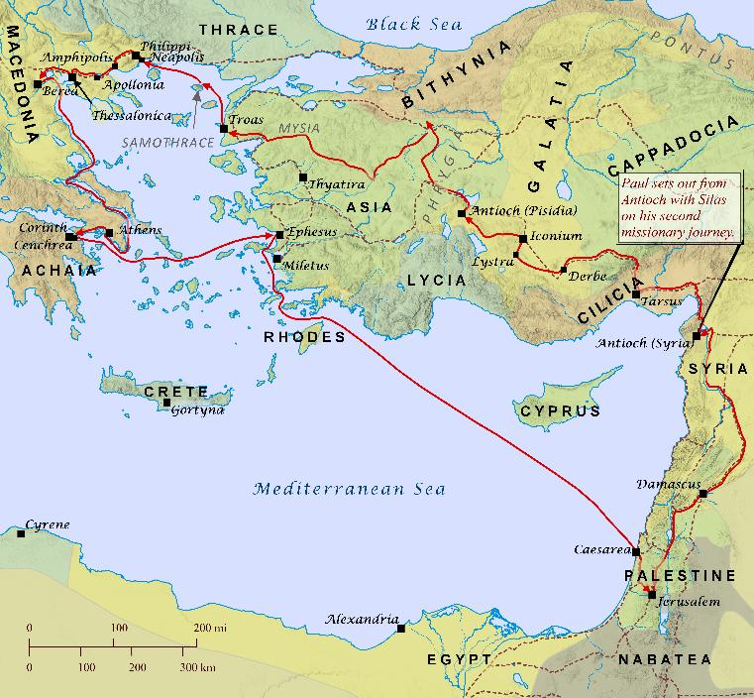
Paul’s
Second
Missionary
Journey
Notes:
When I go for a walk, I need a map! Printouts on table, poster at the front. I will project it at times. Follow along if you wish or just sit back and enjoy the ride!

Slide 8
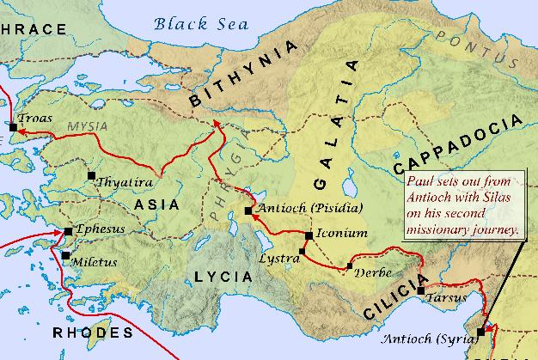
Antioch to Troas (Asian Turkey)
After the Jerusalem Council, Paul travelled through Syria, Cilicia, Derbe, Lystra, Iconium (Acts 15:41-16:5), revisiting his first missionary journey (Acts 14:1-23).
Paul also travelled through Phrygia and Galatia and Mysia. The Holy Spirit blocked him from Asia and Bithynia
(Acts 16:6-7).
Paul arrived in Troas (16:8).
What is this city famous for?
  Siege of Troy ~ 1200 BC, time of Judges.
Notes:
Dardanelles and Bosporus separate Europe from Asia

Slide 9
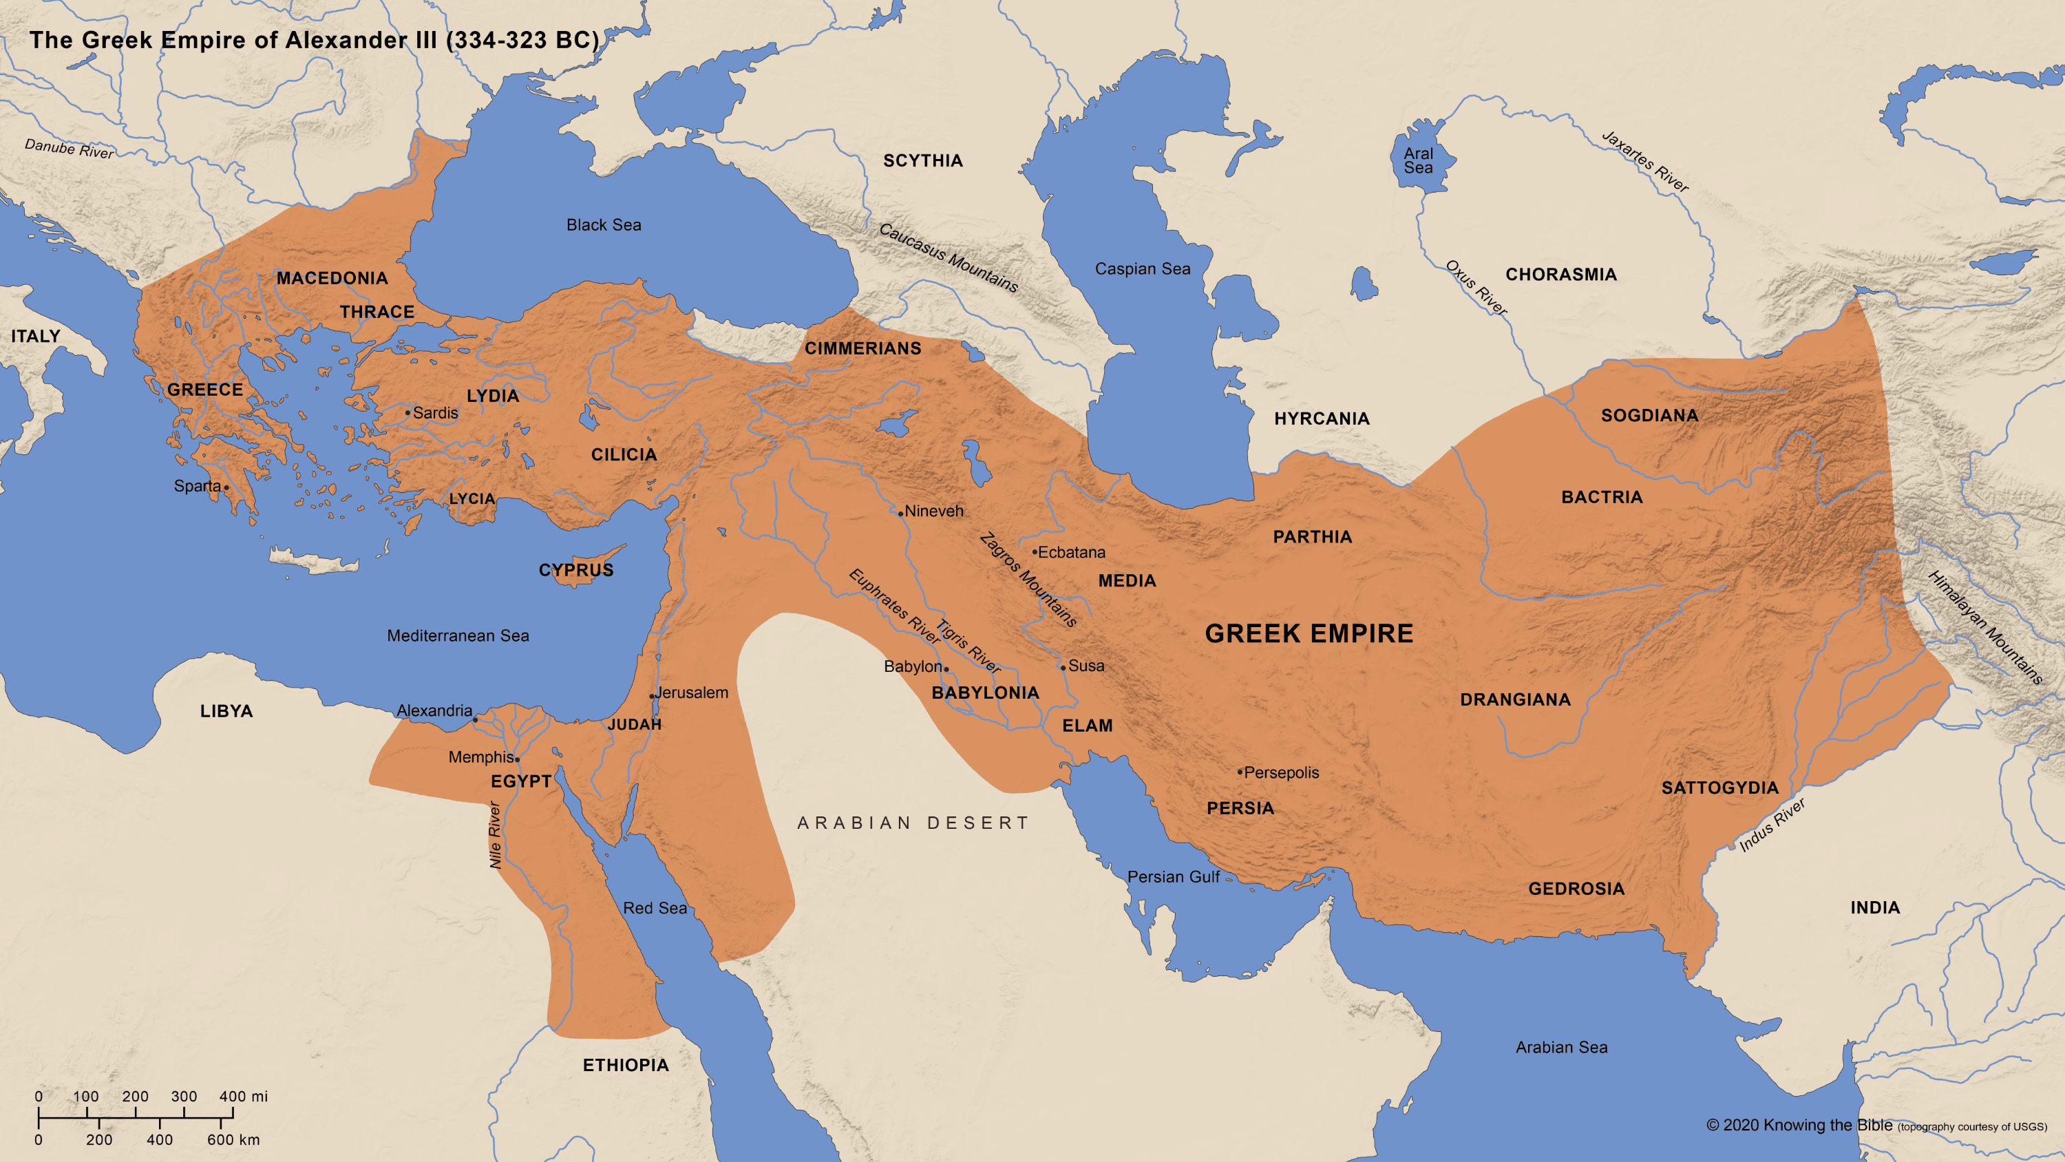
Empires Impacting Our Journey
Roman Empire
63 BC – 1453 AD
Ottoman Empire
1453 – 1918
Greek Empire
331 – 63 BC
Promised
Land
Notes:
The “400 silent years” intertestamental between Malachi and John the Baptist, no new prophecy,
The Greek Empire under Alexander the Great, led to Hellenization and the adoption of “Koine Greek” as the common tongue) throughout the empire, like today’s English.

Slide 10
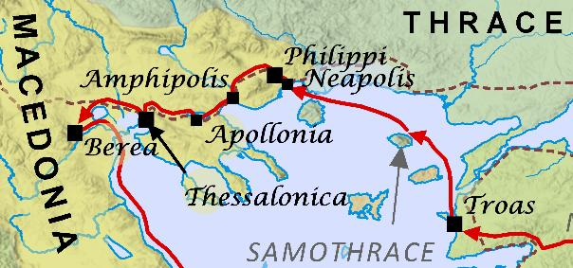
Troas to Philippi
And a vision appeared to Paul in the night: a man of Macedonia was standing there, urging him and saying, “Come over to Macedonia and help us.” And when Paul had seen the vision, immediately we sought to go on into Macedonia, concluding that God had called us to preach the gospel to them. (Acts 16:9-10, ESV)
  “we sought to go on into Macedonia…”
    The first “we” in Acts. This suggests that Luke joined Paul in Troas.
  Paul followed his calling to Europe!

Slide 11
Troas to Philippi (cont’d)
So, setting sail from Troas, we made a direct voyage to Samothrace, and the following day to Neapolis, and from there to Philippi, which is a leading city of the district of Macedonia and a Roman colony.
(Acts 16:11-12, ESV)
  Two days sailing from Troas to Neapolis, 10 miles walking from Neapolis to Philippi.
    Neapolis, “new city,” named in 7th Century BC
    Philippi named in 356 BC after Alexander the Great’s father, Philip.
      “Roman colony” – lots of Romans, retired soldiers.
    An earthquake severely damaged Philippi in 619 AD.
      Its population relocated to Neapolis, renaming it “Christoupolis” to commemorate Paul’s arrival in Europe. They left the ruins of Philippi behind.
        The Ottoman Empire renamed it Kavala ~1500 AD, and this name persists today.

Slide 12
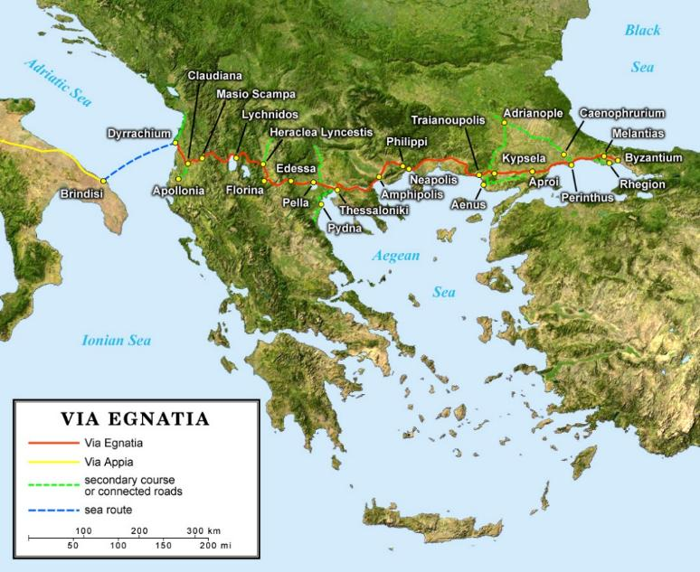
The Egnatian Way
The Romans built roads to move their armies around their empire rapidly.
  These helped spread of the gospel!
Egnatian Way went from Greece’s west coast to Byzantium (Istanbul).
It passed through Philippi and Neapolis.

Slide 13
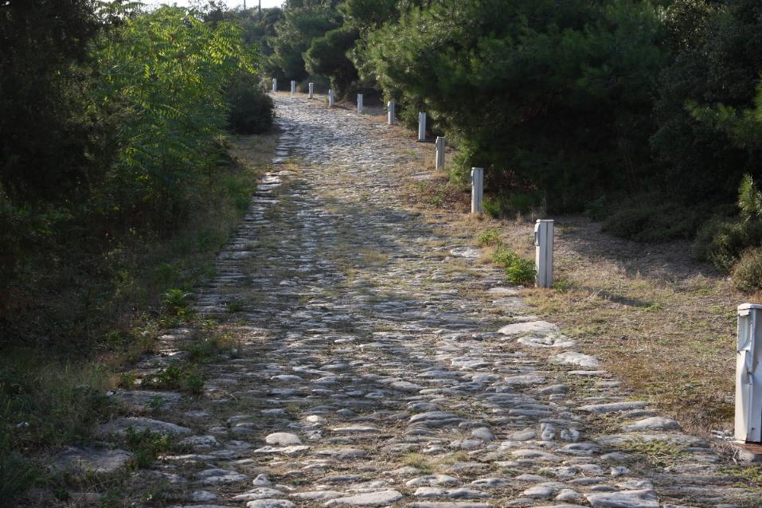
The Egnatian Way
Part of the Egnatian Way still exists outside Kavala.
(i.e. Neapolis or Christoupolis)

Slide 14
Lydia’s Conversion
And on the Sabbath day we went outside the gate to the riverside, where we supposed there was a place of prayer, and we sat down and spoke to the women who had come together. One who heard us was a woman named Lydia, from the city of Thyatira, a seller of purple goods, who was a worshiper of God. (Acts 16:13-14, ESV)
  If there were 10 or more Jews present in a town, a synagogue would be built.
    If there were fewer than that, they would meet outside on the Sabbath, by a river for ceremonial washing.
  Lydia was a God-fearing Gentile from Thyatira, near Ephesus. Purple goods suggest wealth, as purple dye was rare, extracted from snails.
  After accepting Jesus, Paul baptized Lydia in the River Zygakti, which we visited.

Slide 15
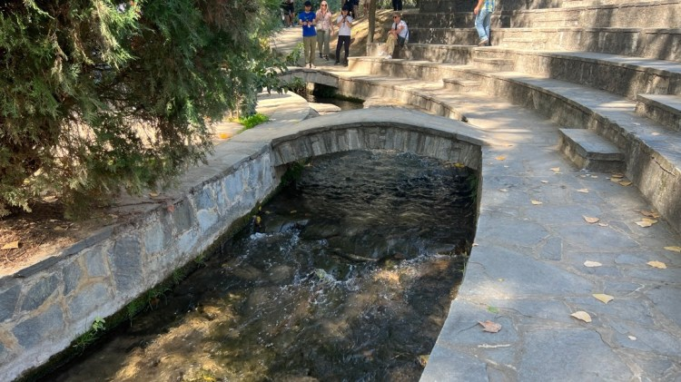
Lydia’s Baptism Site on the River Zygakti
Notes:
NASB labels Lydia as the first convert in Europe.

Slide 16
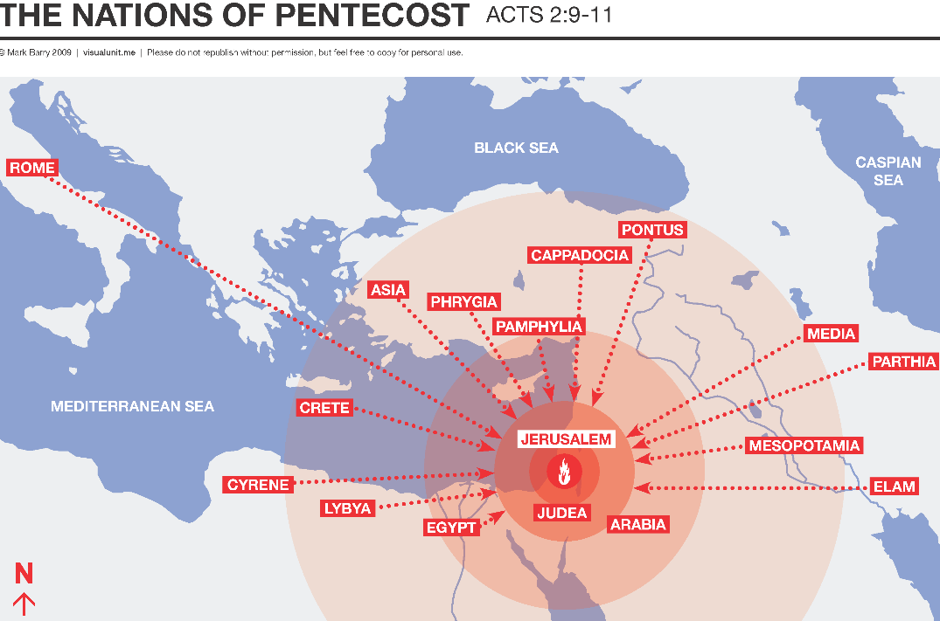
Acts 16:14
Title
First
Convert
in
Europe?
Notes:
There were Jewish Romans at Pentecost who converted to Christianity in Jerusalem. Likely formed a church and converted others.
Lydia was non-Jewish, God-fearer.
Lydia’s conversion about 20 years after Pentecost

Slide 17

Acts 16:16
It happened that as we were going to the place of prayer, a slave woman who had a spirit of divination met us, who was bringing great profit to her masters by fortune-telling.
(Acts 16:16, ESV)
Footnotes?
The NET Bible explains that the Greek literally says “who had a spirit of Python.” Python was the name of the serpent that guarded the oracle of Delphi. According to Greek mythology, it lived at the foot of Mount Parnassus and was killed by Apollo. The word came to designate a person who was thought to have a spirit of divination. Her presence suggests a supernatural encounter involving Paul and her “spirit.” It also highlights the challenge of translation!
To a first-century Greek audience, this illustrated that Christ, channeled through Paul, was far mightier than Apollo by defeating the python with a single sentence:
“I command you in the name of Jesus Christ to come out of her.” (Acts 16:18)
Notes:
Skip to Acts 16:16
Ask a difficult question.
Anyone’s Bible have footnotes for Acts 16:16? Difficult question because the font is so small.
Illustrates the challenge of translation across languages and two millenia!

Slide 18
Exorcism and Imprisonment
But when her owners saw that their hope of gain was gone, they seized Paul and Silas and dragged them into the marketplace before the rulers. And when they had brought them to the magistrates, they said, “These men are Jews, and they are disturbing our city….And when they had inflicted many blows upon them, they threw them into prison, ordering the jailer to keep them safely. (Acts 16:19-20,23, ESV)
  Roman magistrates imprisoned Paul without trial, forbidden to be done to Roman citizens, but Paul did not mention his citizenship.
  No “we” here which suggests Luke was not imprisoned. The next use of the first person is Acts 20, when Paul returns to Philippi during his third missionary journey.
  Paul wrote his letter to the Philippians about 10 years later.

Slide 19
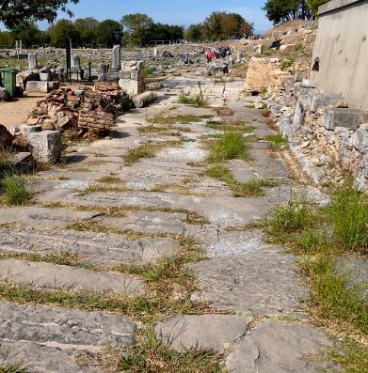
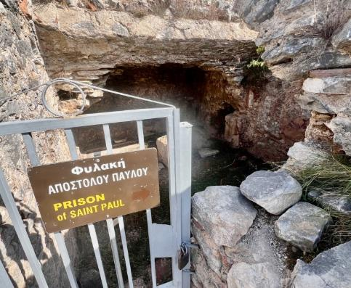
The Earthquake
and suddenly there was a great earthquake, so that the foundations of the prison were shaken. (Acts 16:26, ESV)
  Egnatian Way and Paul’s prison remain among the ruins destroyed by subsequent earthquakes.

Slide 20
The Departure from Philippi
And the jailer reported these words to Paul, saying, “The magistrates have sent to let you go. Therefore come out now and go in peace.” But Paul said to them, “They have beaten us publicly, uncondemned, men who are Roman citizens, and have thrown us into prison; and do they now throw us out secretly? No! Let them come themselves and take us out.” The police reported these words to the magistrates, and they were afraid when they heard that they were Roman citizens. (Acts 16:36-38, ESV)
  I have intentionally skipped the jailer’s conversion!
  Paul had not been interested in protecting himself.
    His actions protected the new Christian church in Philippi.
    He continued his journey on foot after severe beatings.
Notes:
Now we jump to chapter 17, having just left Philippi.

Slide 21
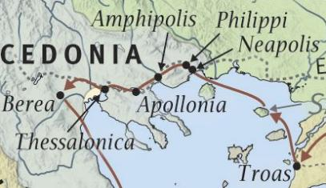
Thessalonica
Now when they had passed through Amphipolis and Apollonia, they came to Thessalonica, where there was a synagogue of the Jews. And Paul went in, as was his custom… (Acts 17:1-2a, ESV)
  It’s a 100-mile walk from Philippi to Thessalonica
  along the Egnatian Way.
  Here, there were enough Jews for a synagogue.
  Paul converted some Jews and Gentiles,
  but was chased out of the city , again! (17:2b-9)
  A couple of years later, Paul wrote two encouraging letters to Thessalonica’s young church that faced persecution, i.e., First and Second Thessalonians.
Notes:
There used to be a controversy about this passage.

Slide 22

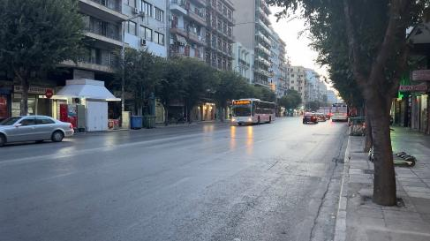
Politarch?
And the people and the city authorities were disturbed when they heard these things. (Acts 17:8, ESV)
  Luke used the word politarch.
  For centuries, this word was not found in any other texts,
  so critics in ~1800 identified this as a mistake by Luke.
  But, in 1835, the same word was identified in the
  Roman Varder Gate from the 2nd Century AD over the Egnatian Way in Thessalonica, vindicating Luke!
  The Egnatian Way remains
  the main street through the
  center of the city:
Notes:
It is along the Egnatian Way that we must continue our journey.

Slide 23
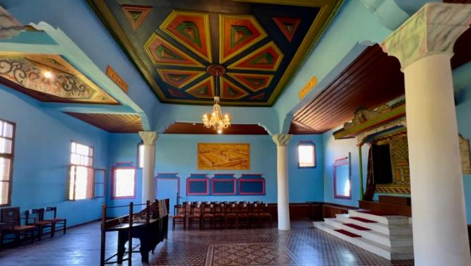
Berea not Rome
The brothers immediately sent Paul and Silas away by night to Berea, and when they arrived they went into the Jewish synagogue.(Acts 17:10, ESV)
  Berea was 45 miles from Thessalonica, ~3 days walk.
  Instead of going to Rome, Paul left the Egnatian Way
In Berea, a synagogue from 1850 is on the site of the one Paul visited. Through its windows, we heard the Tripotamos River rushing by.
Today, the synagogue is a memorial to 150 children that the Nazis murdered there in 1943.
They do not celebrate Paul!

Slide 24
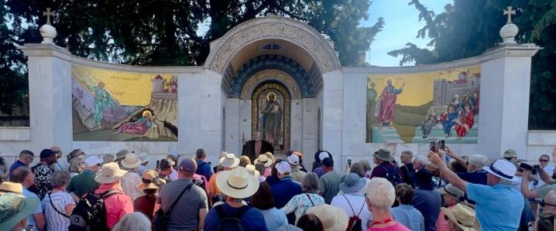
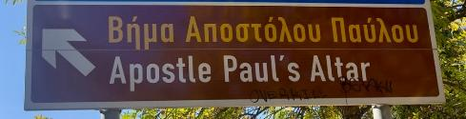
Berea’s Bema
Also, Paul engaged with Gentiles (17:12b).
Paul might have spoken from the “Bema” (raised stone platform) in the old central square.
Tradition has associated a central location in the town with Paul.
Notes:
During our visit, another tour guide played the role of Paul

Slide 25
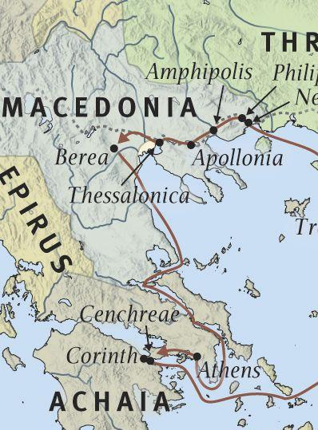
Berea to Athens
But when the Jews from Thessalonica learned that the word of God was proclaimed by Paul at Berea also, they came there too, agitating and stirring up the crowds. Then the brothers immediately sent Paul off on his way to the sea, but Silas and Timothy remained there. Those who conducted Paul brought him as far as Athens, and after receiving a command for Silas and Timothy to come to him as soon as possible, they departed. (Acts 17:13-15, ESV)
We traveled by land.

Slide 26
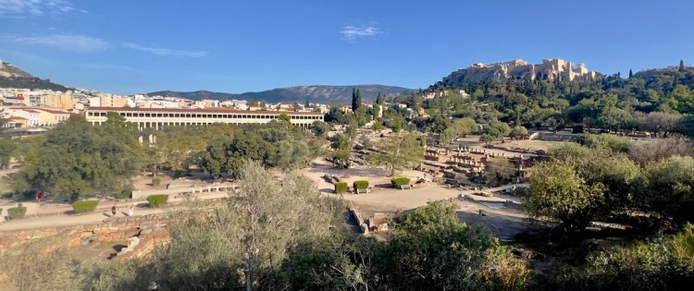
Paul in Athens
Now while Paul was waiting for them at Athens, his spirit was provoked within him as he saw that the city was full of idols. So he reasoned in the synagogue with the Jews and the devout persons, and in the marketplace every day with those who happened to be there.
(Acts 17:16-17, ESV)
Athens was like a
“university town.”
Agora is Greek
for “marketplace”
Notes:
Now all the Athenians and the foreigners who lived there would spend their time in nothing except telling or hearing something new. (Acts 17:21)
The ancient Stoa has been rebuilt, which would have been like an ancient shopping mall.

Slide 27
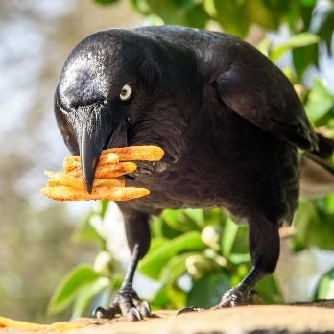
Another Translation Challenge
Some of the Epicurean and Stoic philosophers also conversed with him. And some said, “What does this babbler wish to say?” (Acts 17:18, ESV)
  Epicurean philosophers identified pleasure as the highest good.
  Stoics prioritized reason and logic.
  A spermologos (σπερμολόγος), literally a “seed-picker”
    Like a crow?
    A person who acquires information from different sources and passes it on to others. However, they lack comprehension concerning the matter. They spread information superficially, like a plagiarist.
    It was a very strong insult.
Notes:
KJV: Babbler
CSB: ignorant show off.
HCSB: pseudo-intellectual
MSG: Moron
NASB: Scavenger of tidbits

Slide 28
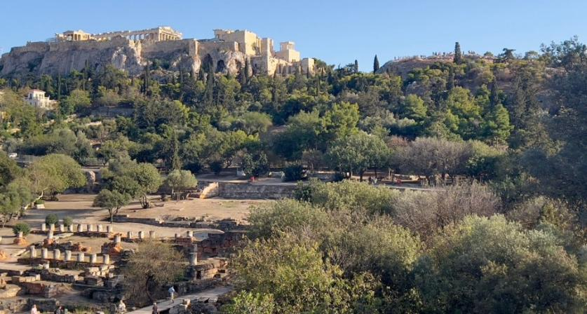
Paul and the Aeropagus
And they took him and brought him to the Areopagus (Acts 17:19, ESV)
  The Areopagus, Athens’ governing council, met on Mars Hill.
  It met in the shadow of temples to Athena on the Acropolis, which celebrated Greece’s great victories.
  Imagine Paul…

Slide 29
Paul and the Aeropagus
So Paul, standing in the midst of the Areopagus, said: “Men of Athens, I perceive that in every way you are very religious. For as I passed along and observed the objects of your worship, I found also an altar with this inscription: ‘To the unknown god.’ What therefore you worship as unknown, this I proclaim to you. The God who made the world and everything in it, being Lord of heaven and earth, does not live in temples made by man, nor is he served by human hands, as though he needed anything, since he himself gives to all mankind life and breath and everything.(Acts 17:22-25, ESV)
  Paul’s message succeeded in converting Dionysius and Damaris, but he then left Athens for Corinth. (Acts 17:34)

Slide 30
Paul in Corinth
After this Paul left Athens and went to Corinth. And he found a Jew named Aquila, a native of Pontus, recently come from Italy with his wife Priscilla, because Claudius had commanded all the Jews to leave Rome. And he went to see them, and because he was of the same trade he stayed with them and worked, for they were tentmakers by trade.
(Acts 18:1-3, ESV)
  Pontus - also mentioned at Pentecost (Acts 2:9) and 1 Peter 1:1.
  Jews had been expelled from Rome. Perhaps this was why Paul did not go there.
  Tentmakers – at the time of the “Isthmian Games;” tents were in high demand.
  Paul wrote 1 and 2 Thessalonians from here.
Notes:
Next slide looks closer at Corinth

Slide 31
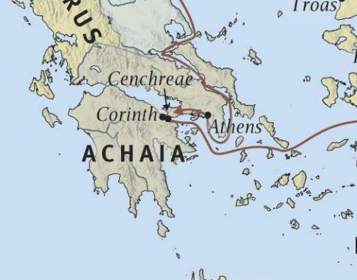
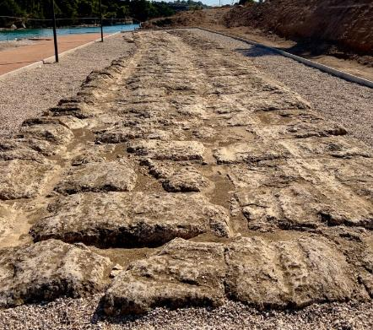
Corinth
Corinth was on an isthmus connecting Achaia with the rest of Greece.
Ships would bring cargo to Corinth rather than sail around which was treacherous. Boats were dragged along the Diolkos, a 4-mile trail built in 600 BC that crossed the isthmus, and replaced by the Corinth Canal in 1893.
This made Corinth an extremely busy crossroads, creating the environment of debauchery that Paul addressed in his letters to the Corinthians, written about 5 years later.

Slide 32
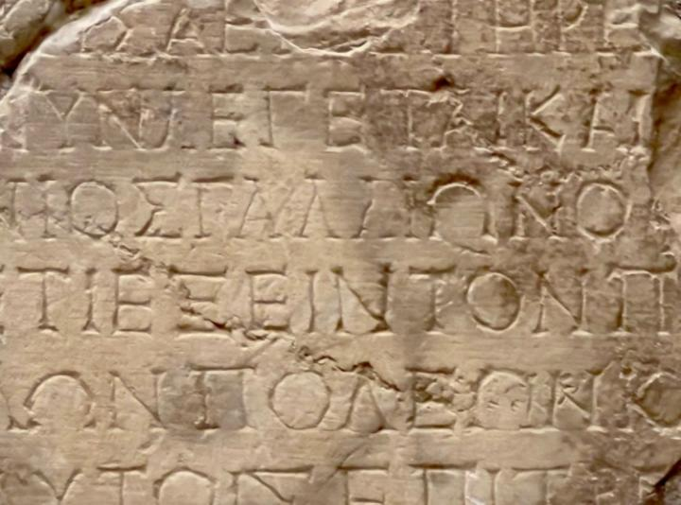
Dating of Acts 18
But when Gallio was proconsul of Achaia (Acts 18:12a, ESV)
The “Gallio Inscription” is at Delphi’s archaeological museum, after being discovered in 1905. It is a copy of a letter from Claudius to the Delphians.
You can see “ΓΑΛΛΙΟ” (Gallio).
Proconsuls, such as Gallio, only served for one year.
The inscription notes that it is the 26th year of Roman emperor Claudius.
The timing of Paul’s appearance before Gallio can be dated to
51-52 AD with confidence.

Slide 33
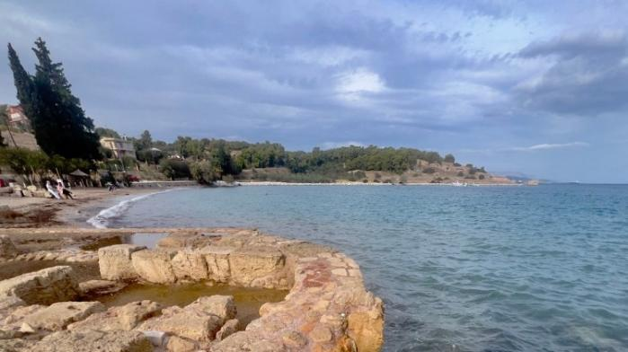
Paul Leaves Europe for Jerusalem
After this, Paul stayed many days longer and then took leave of the brothers and set sail for Syria, and with him Priscilla and Aquila. At Cenchreae he had cut his hair, for he was under a vow. (Acts 18:18, ESV)
  Cenchreae was a small port, about 9 miles south of Corinth; archaeological remnants are visible both above and below the waterline.
Notes:
SEN-kree-uh

Slide 34
Conclusions
Paul brought the gospel to Europe, planting several churches.
Paul shared the gospel in a wide variety of settings:
  Philippi – a gathering of Jews and God-fearers, exorcism of the python-spirit.
  Thessalonica – the synagogue
  Berea – the synagogue and the town square
  Athens – the marketplace and the Areopagus, the center of philosophical exchange
  Corinth – the synagogue and Gentiles, in the city of debauchery.
He travelled a long way on foot after imprisonments and beatings.
The narrative is confirmed by retracing Paul’s footsteps.
  The biblical account is real!
You can ask Robert difficult questions ☺.

Slide 35

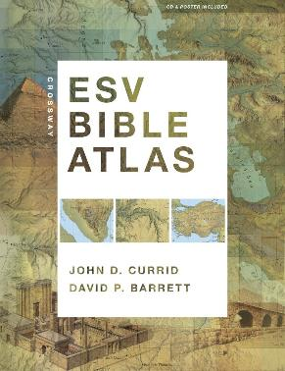
References and Further Reading
The Apostle: A Life of Paul by John Pollock. Written as a biography of Paul, using the biblical text as the primary account and filling the gaps as responsibly as possible.
The Crossway ESV Bible Atlas.

Slide 36
Appendix
Slides that didn’t make the cut due to time constraints.

Slide 37
Timeline of Empires Impacting Biblical Events
Roman Empire
63 BC – 1453 AD
Ottoman Empire
1453 – 1918
Greek Empire
331 – 63 BC
Assyrian Empire
911-609 BC
Promised
Land
Persian Empire
539-331 BC
Babylonian Empire
626-539 BC
Egyptian Empire
~3000-858 BC
Notes:
722 BC – Northern Kingdom taken by Assyria
586 BC – Nebuchadnezzar destroys Solomon’s Temple
Esther, 483-473 BC, in Susa
The “400 silent years” intertestamental between Malachi and John the Baptist, no new prophecy,
The Greek Empire under Alexander the Great, led to Hellenization and the adoption of “Koine Greek” as the common tongue) throughout the empire, like today’s English.
Rome, let things stay the same, as long as serve the empire. Build roads.

Slide 38
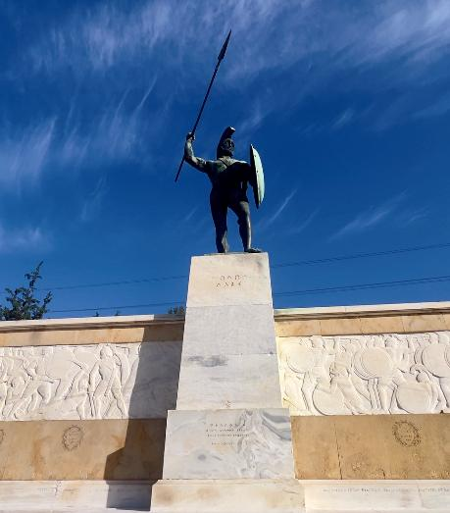
Thermopylae
Thermopylae is the site of the battle between General Leonidas with 300 Spartan Soldiers and Xerxes leading the Persian invaders in 480 BC. This is the subject of the movie “The 300” and is the central theme of the legend of the Spartans.
While that battle was lost, the invading Persians suffered so many losses that they were defeated by the Greeks the following year, forcing Xerxes to return to Susa. Xerxes' name in Aramaic was Ahasuerus, and soon after returning home, he married Queen Esther.
Notes:
ay-haz-yoo-EER-uhs

